Slide 1
Obstacle detection buzzer
By team-UNDERDOGS

Slide 2
Components:
Arduino Nano
Buzzer
Ultrasonic sensor
Breadboard
Jumper wires
LED
NOTE: As for now, Arduino nano is connected to the computer, ,but we can also operate it independently on a battery power.

Slide 3
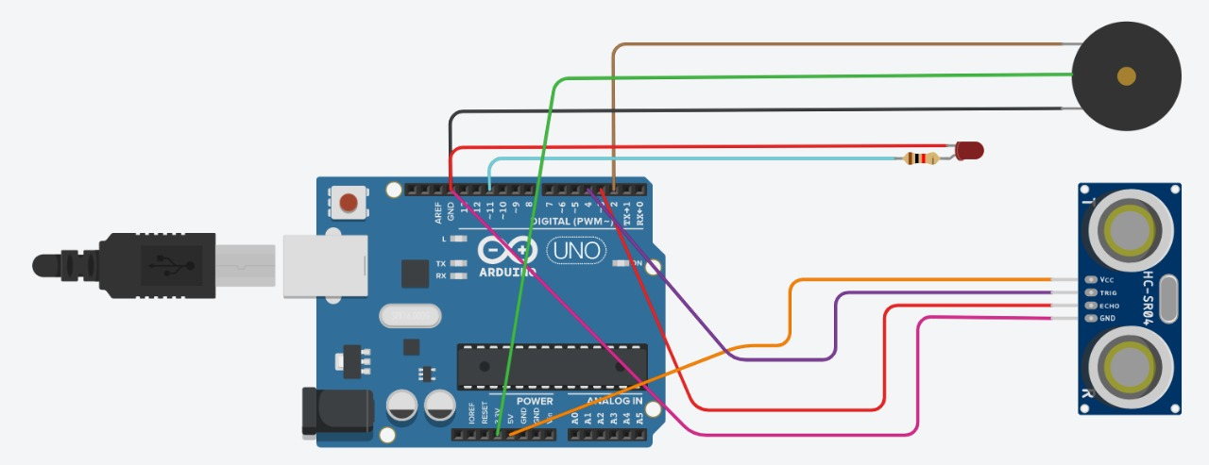
Circuital diagram:
Buzzer
Ultrasonic sensor

Slide 4
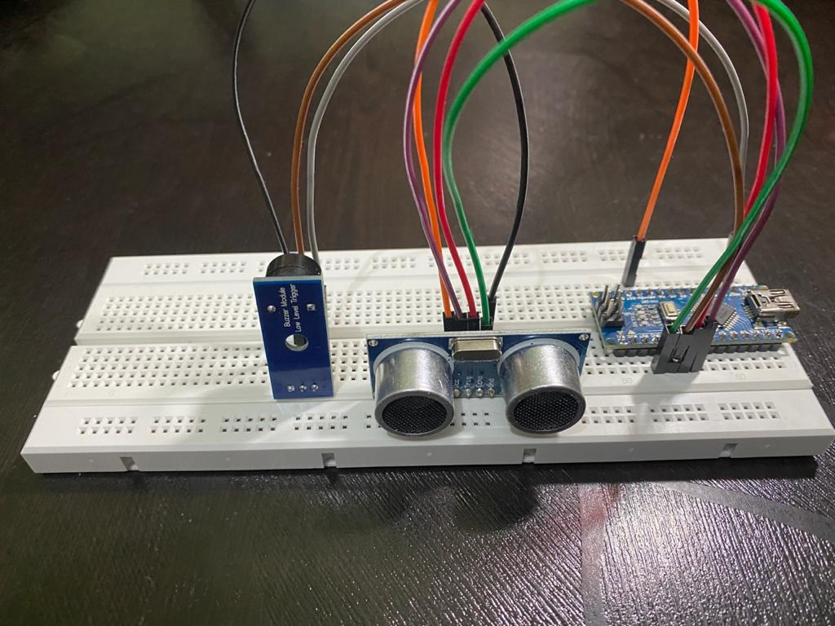
Prototype
Buzzer
Ultrasonic sensor

Slide 5
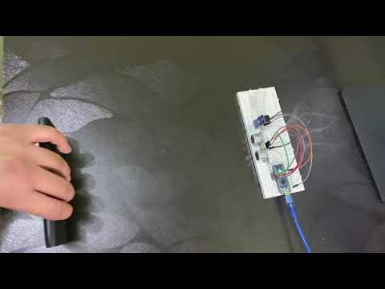
Working Video
The setup is connected to a computer to see the calculated distance as shown in the video (end).

Slide 6
Thank You

